Slide 1
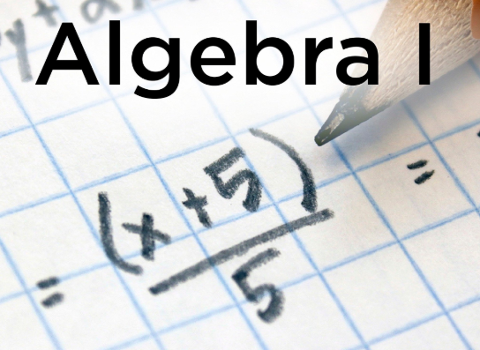
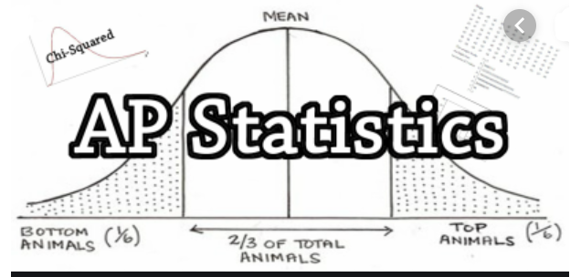
Welcome Parents
Back to School Night
2021 - 2022
PARENTS:
Click on your child’s class to see your classes powerpoint.

Slide 2
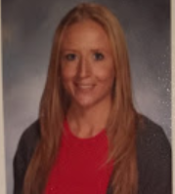
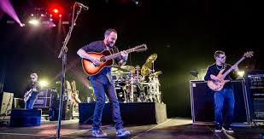
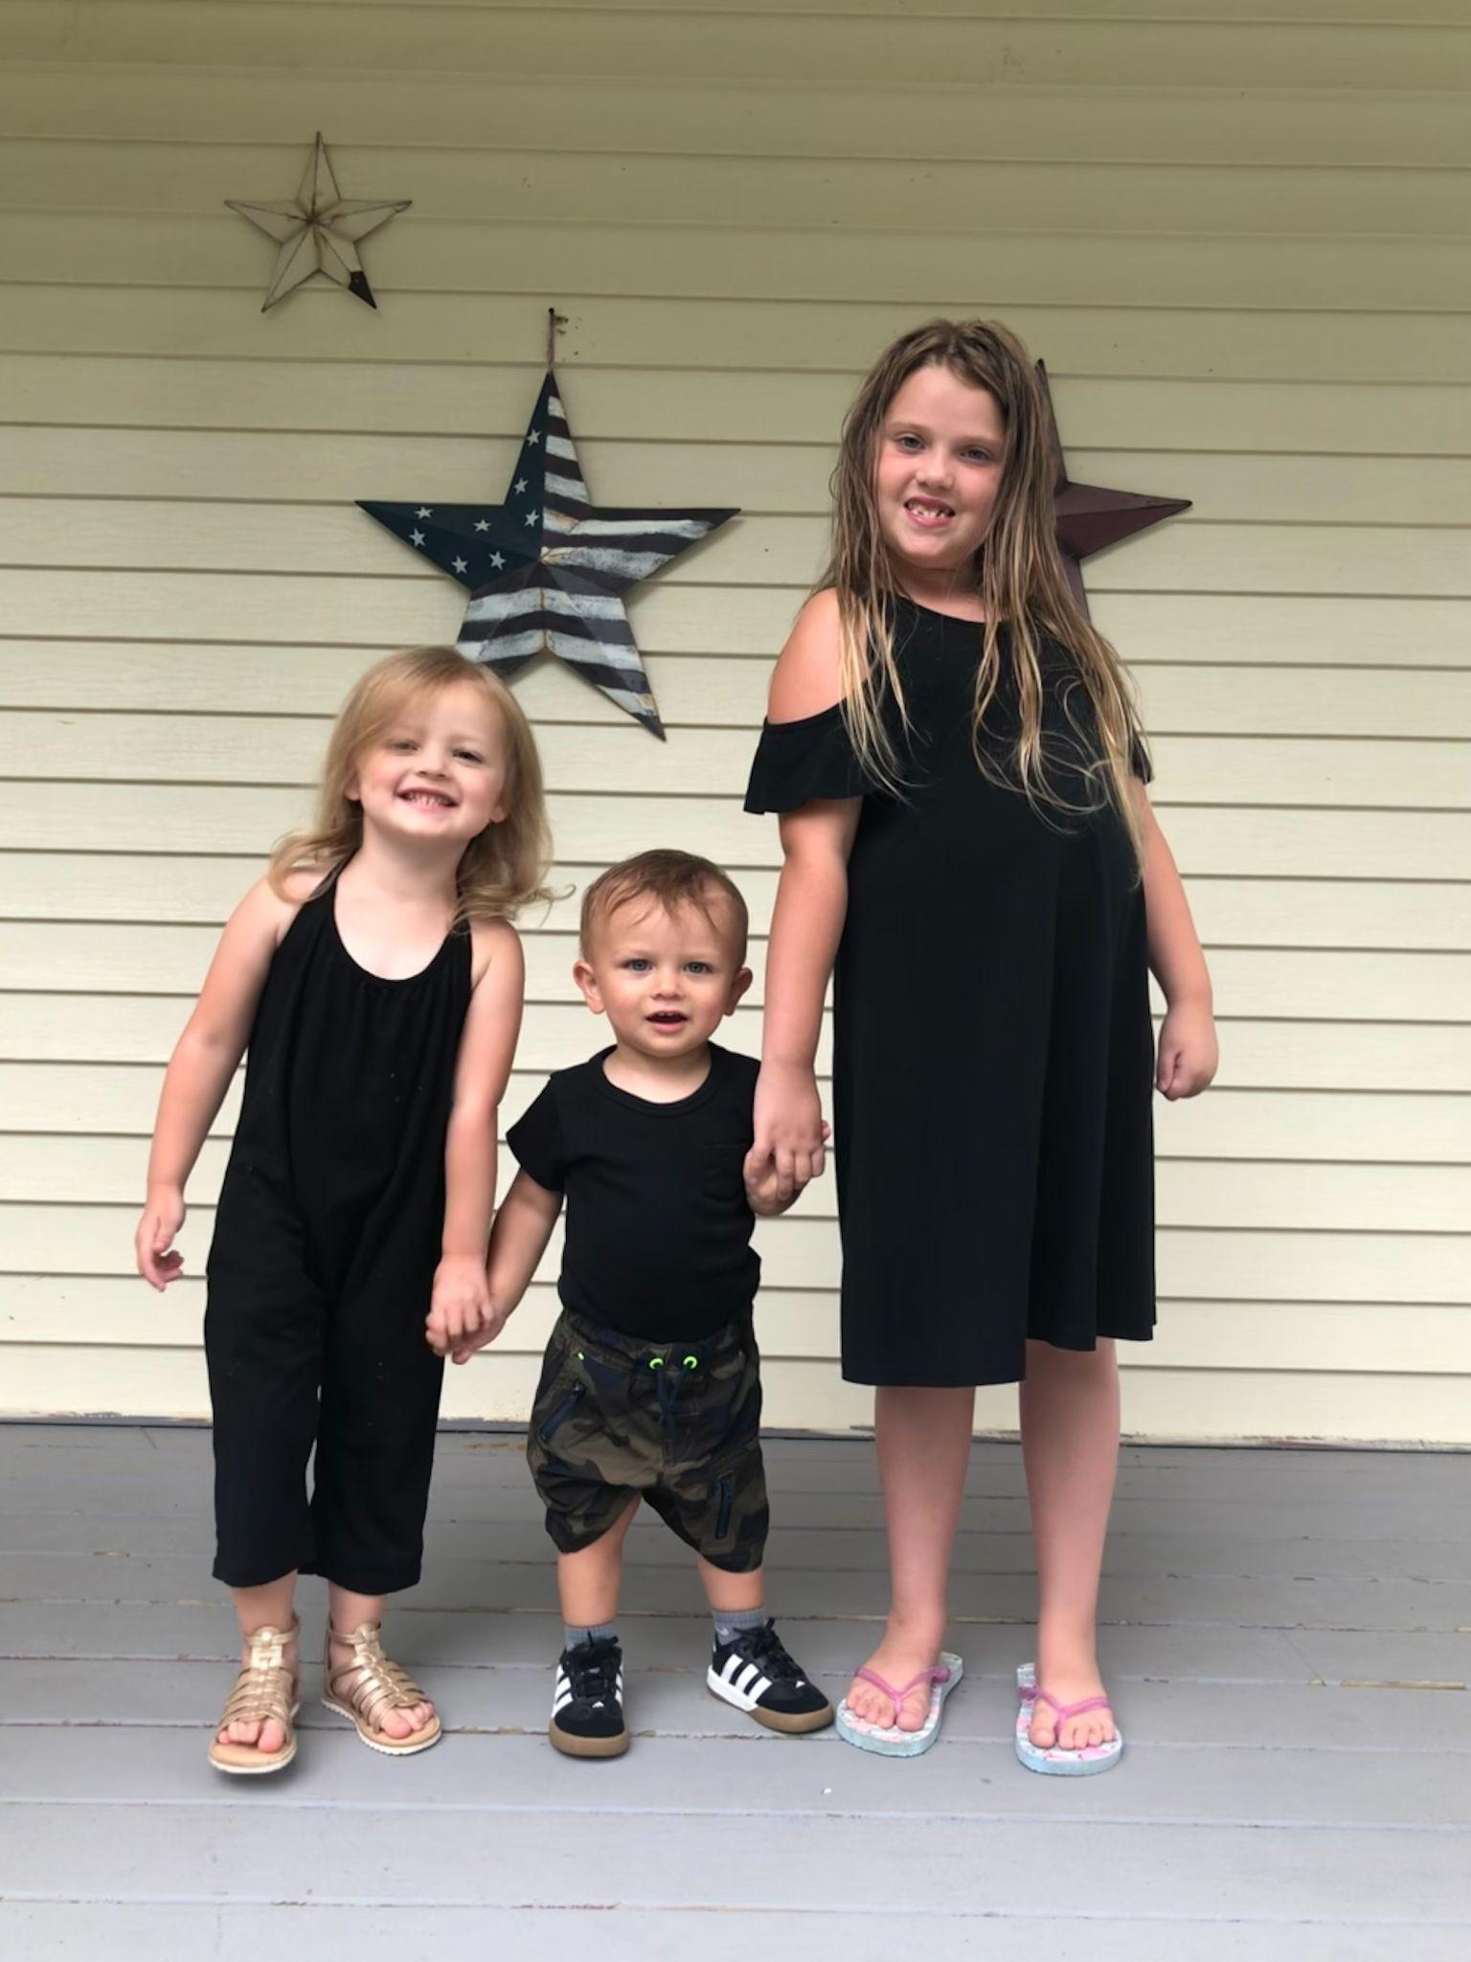
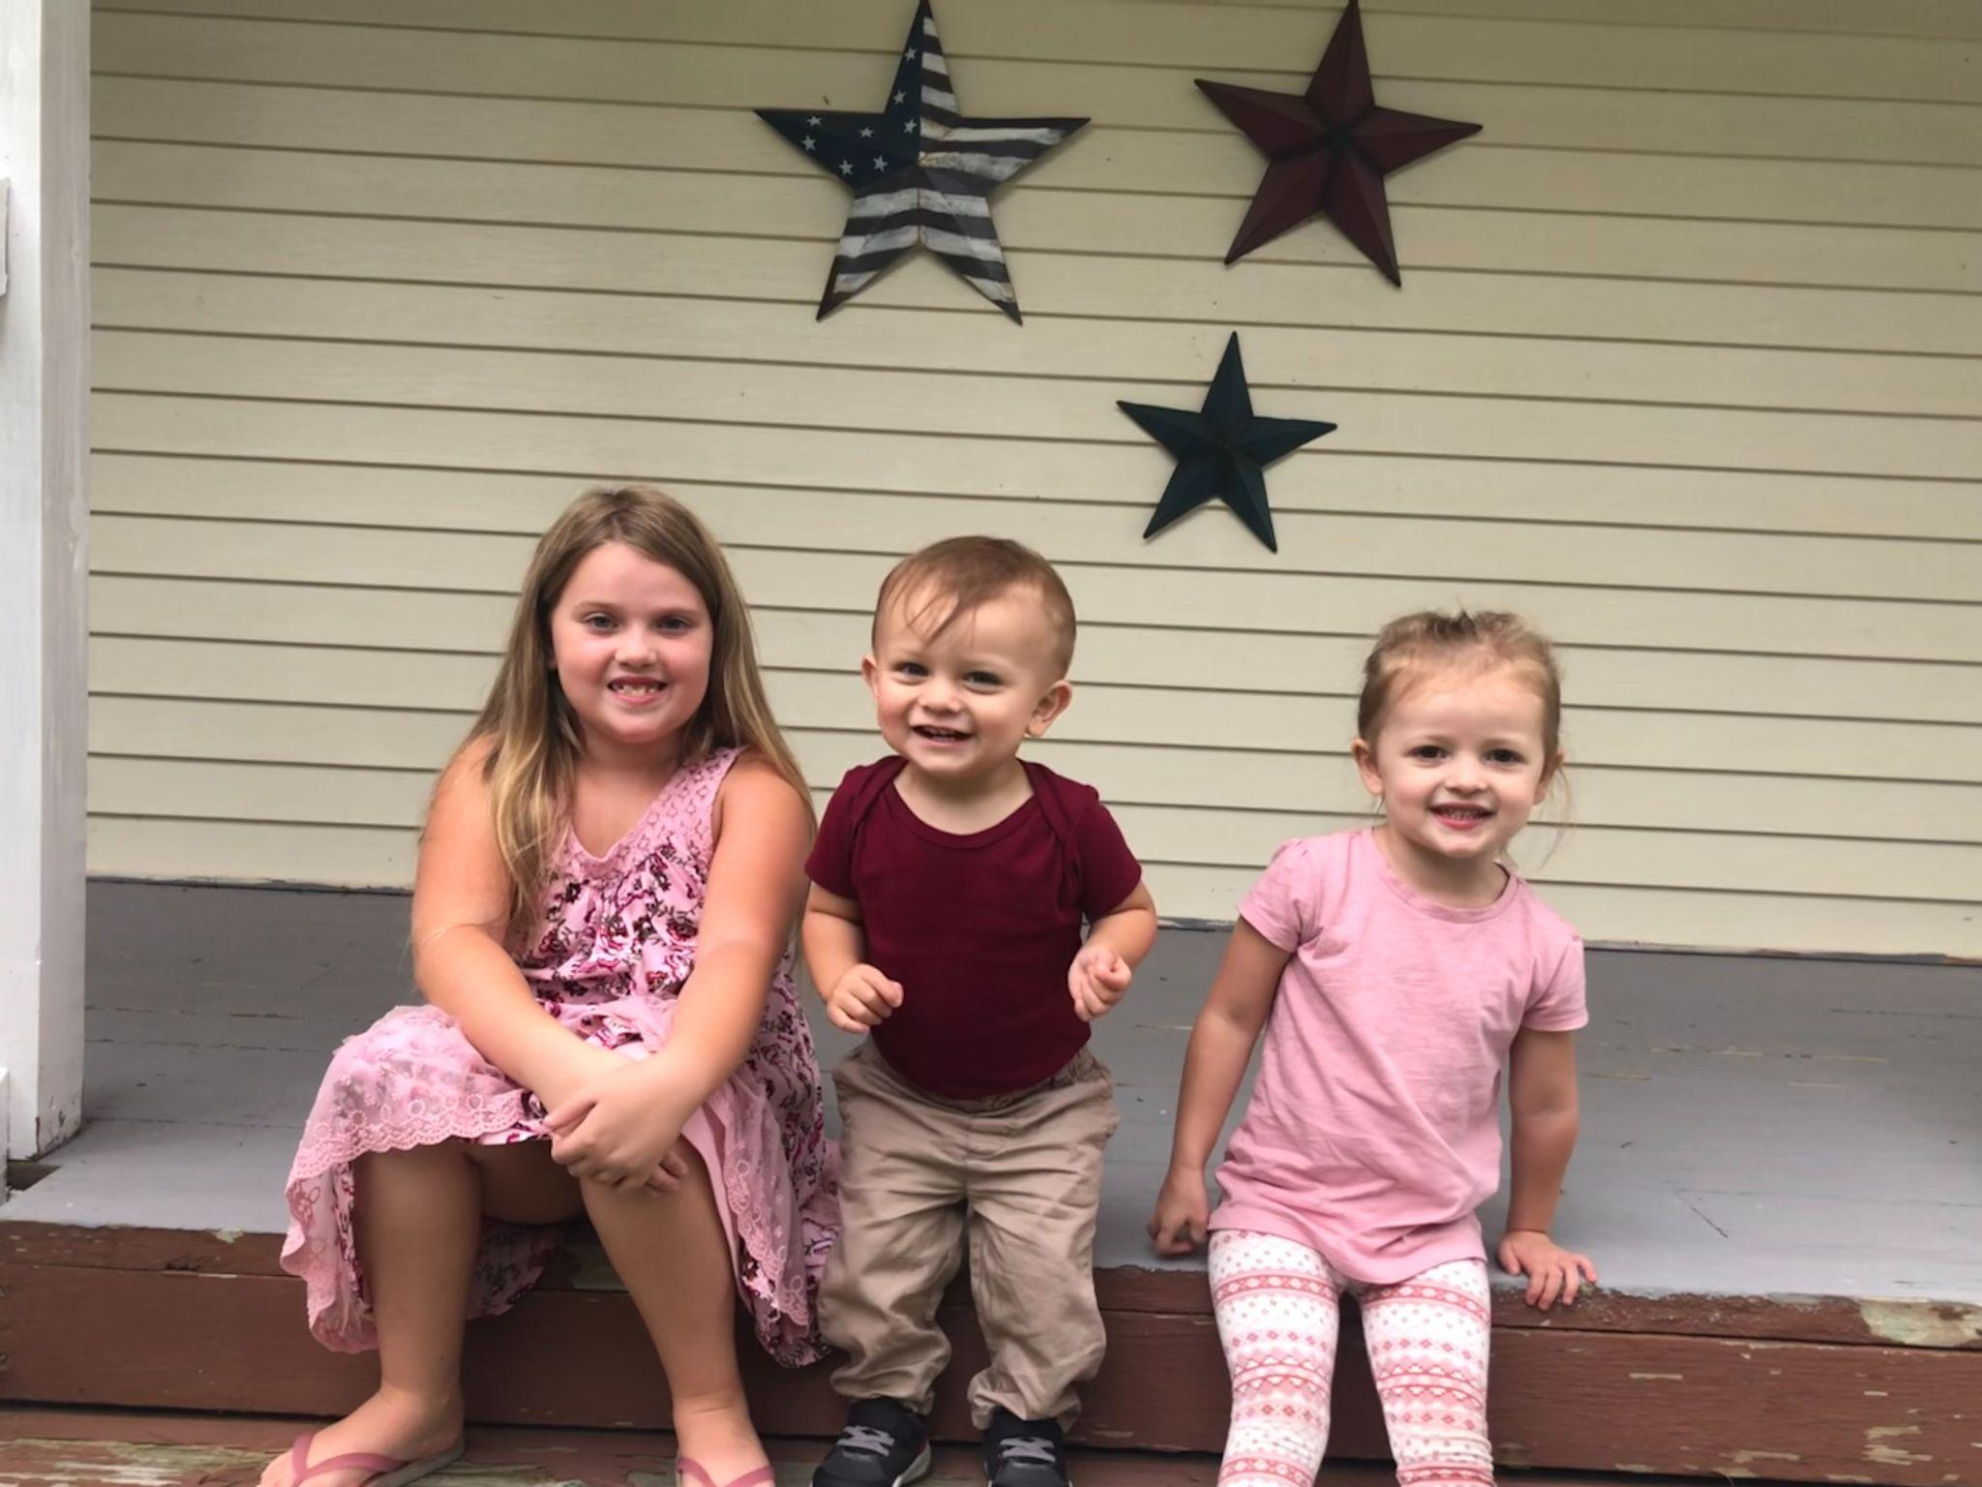
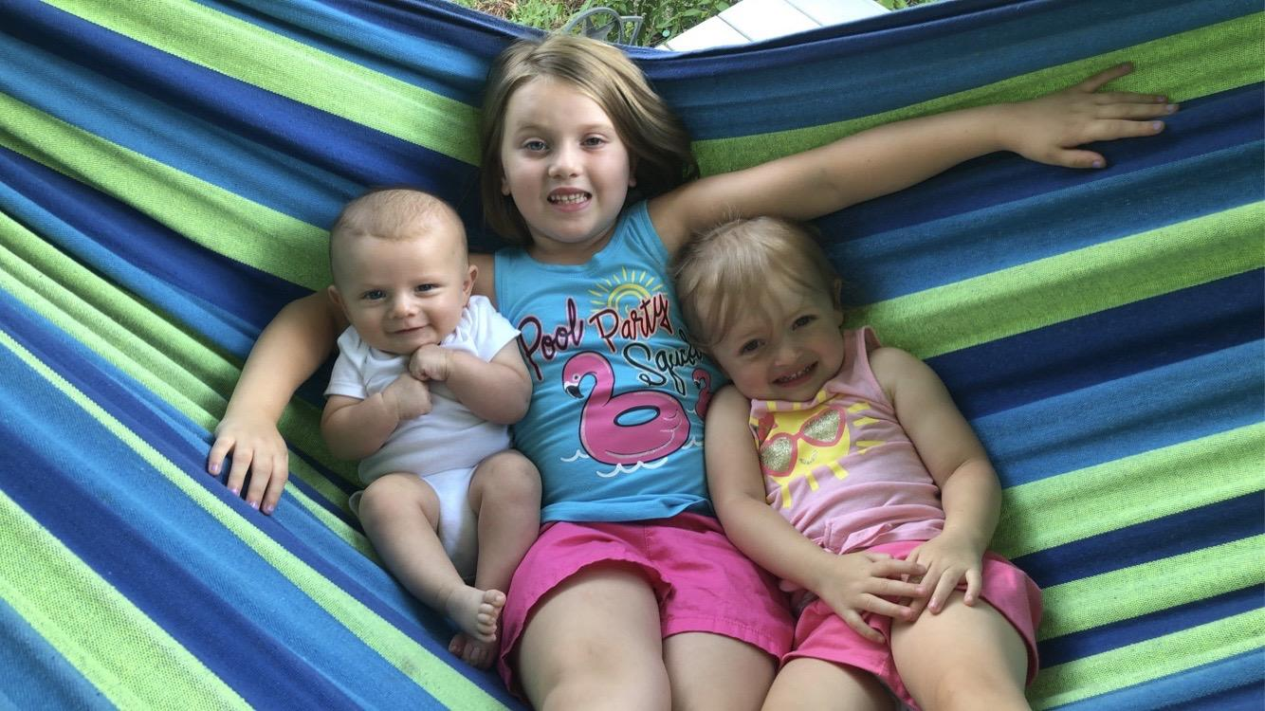
All About Mrs. Lardieri
(Formerly known as Ms. Mascher)
Have worked at Liberty since 2007 and have taught: Algebra I, II, Geometry, Prob&Stats and AP Stats
I am happily married with three children:
Harper 7, Addison 3, Baby Joey 16 months
I love Dave Matthews Band and have been to 50+ concerts

